Slide 1
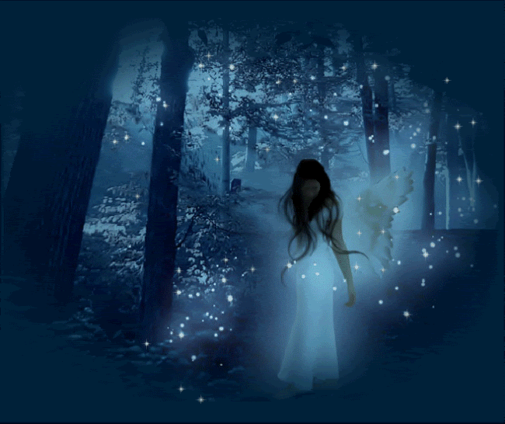
Heroes and Villains
in fantasy texts

Slide 2
LEARNING GOALS
DRIVING QUESTIONS
What is a protagonist?
​What is an antagonist?
​What is character development?
​What is a hero in fantasy fiction?
What is an anti-hero?
What kinds of villains are in fantasy fiction?

Slide 3
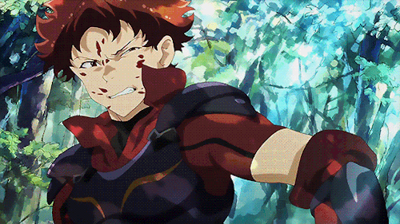
PROTAGONISTS
A protagonist is the main character we are positioned to side with in a story. (In Harry Potter, we are pro-Harry and anti-Voldemort).
In fantasy fiction, the protagonist is usually the hero or heroine of the story. The protagonist also develops or changes as the story goes on, becoming stronger, wiser or more skilled. We call this character development.

Slide 4
PROTAGONISTS
Name as many fantasy protagonists as possible?
Would you consider all of them heroes? Why/Why not?
Choose one of the heroes you have mentioned and describe their character development. (How and why did the character change or grow in the story?)

Slide 5
THE ANTI-HERO
An anti-hero is NOT a villain. An anti-hero is a protagonist who is somehow flawed or does not have the usual qualities or attributes of a traditional hero. S/he may not be brave or adventurous, honest or virtuous or may have some other flaw. Writers create anti-heroes because they are often much more interesting characters than traditional heroes. They have more ability to develop and the reader is never quite sure what they will do.

Slide 6
THE ANTI-HERO
Identify one anti-hero you have come across in a novel, film or television.
Explain why it is that you consider this character an anti-hero.

Slide 7
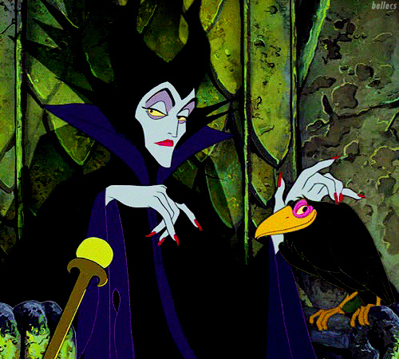
ANTAGONISTS
The antagonist of the story is the person we are positioned to dislike or the person/creature that stands in the way of the hero's success. In fantasy fiction, the antagonist is often referred to as a villain.

Slide 8
ANTAGONISTS
Some fantasy antagonists are pure evil but some of the most terrifying fantasy villains are those for whom we feel some sympathy. Snow White's stepmother with her fading beauty and the terribly rejected Tom Riddle in Harry Potter are antagonists with whom the audience can momentarily empathise. Perhaps their moments of humanity make them more realistic and therefore, more frightening.

Slide 9
ANTAGONISTS
Villains in fantasy fiction usually represent the idea of evil. Though the characters are fictional, the causes of their evil are often very real - a broken heart that turns a normal person bitter and twisted; jealousy; a harsh, unloving childhood; rejection; etc.

Slide 10
ANTAGONISTS
Name as many fantasy villains as you can.
Who is your favourite fantasy villain? Why?
Identify one fantasy antagonist that you almost feel sorry for at times? Why?

